Slide 1
Vending machine problem
-Coin change algorithm

Slide 2
Team members
K. Sai Nikhitha (AP22110010498)
K. Mohana Samanya (AP22110010523)
P. Monika (AP22110010460)
B. Lakshmi (AP22110010472)
P. Prasanna (AP22110010479)
K. Sneha (AP22110010518)

Slide 3
agenda
Problem Statement
Algorithm Overview
Code Implementation
Complexity Analysis

Slide 4
Problem statement
The problem statement for the vending machine algorithm based on the coin change problem can be articulated as follows:​
Given a set of coin denominations available in a vending machine and a target amount for which change needs to be returned, the objective is to determine the minimum number of coins required to make the change. The vending machine should return the optimal combination of coins to minimize the total number of coins dispensed while ensuring that the total value of the coins equals the target amount.​
​

Slide 5
Algorithm overview
User Interaction: Prompt user to select an item and insert coins until enough money is provided.
Coin Handling: Keep track of total amount inserted and validate coin denominations.
Check Sufficiency: Compare total amount inserted with item price.
Change Calculation: Determine optimal coin combination for change using a coin change algorithm.
Dispense Item and Change: Provide selected item and return appropriate change.

Slide 6
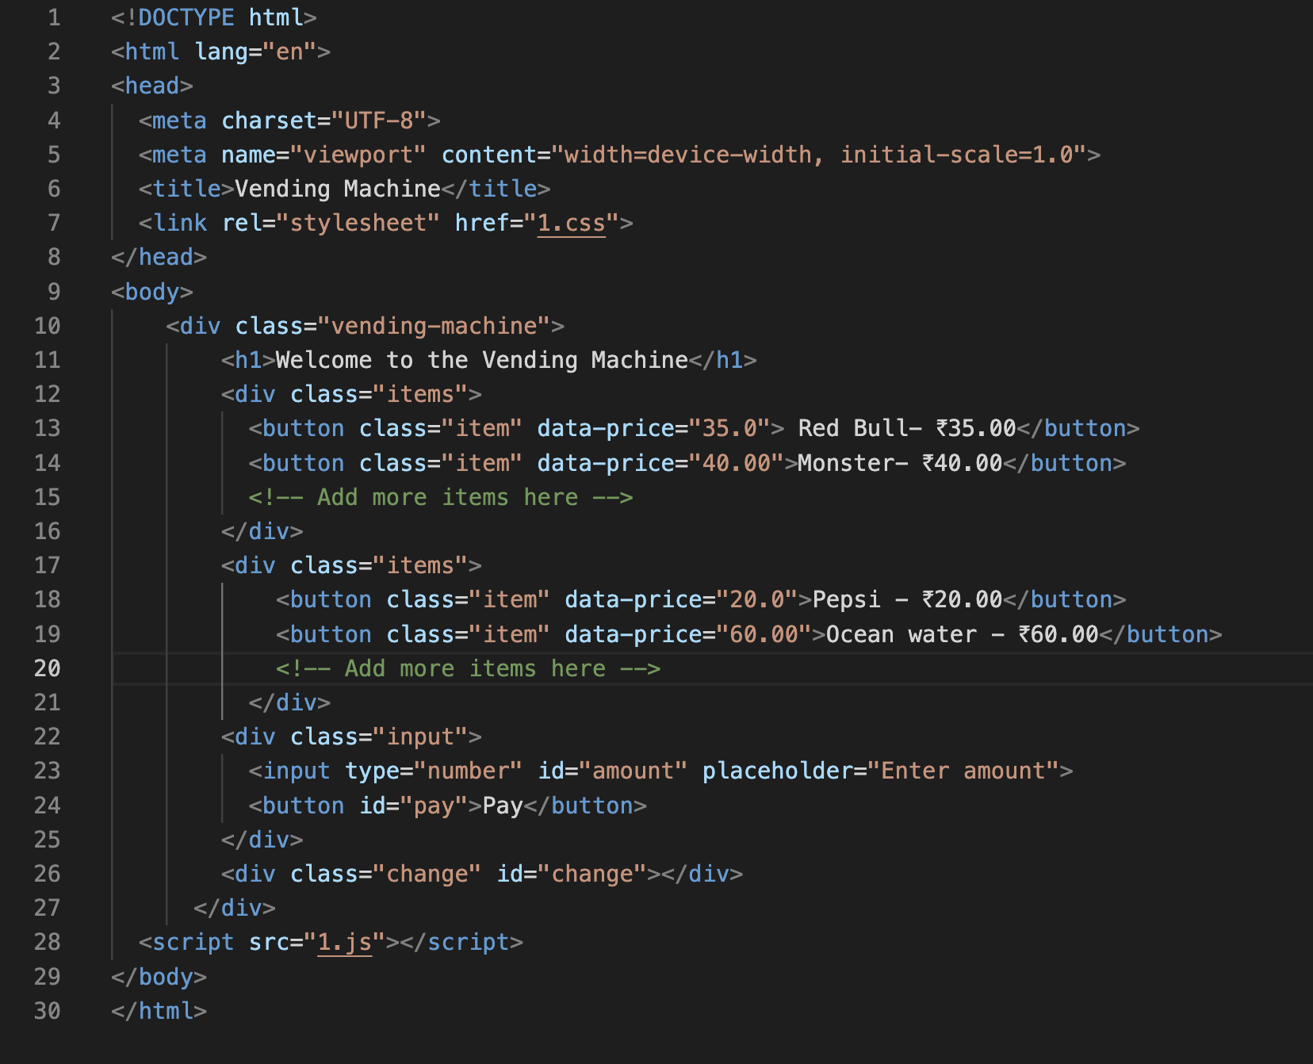
Code implementation

Slide 7
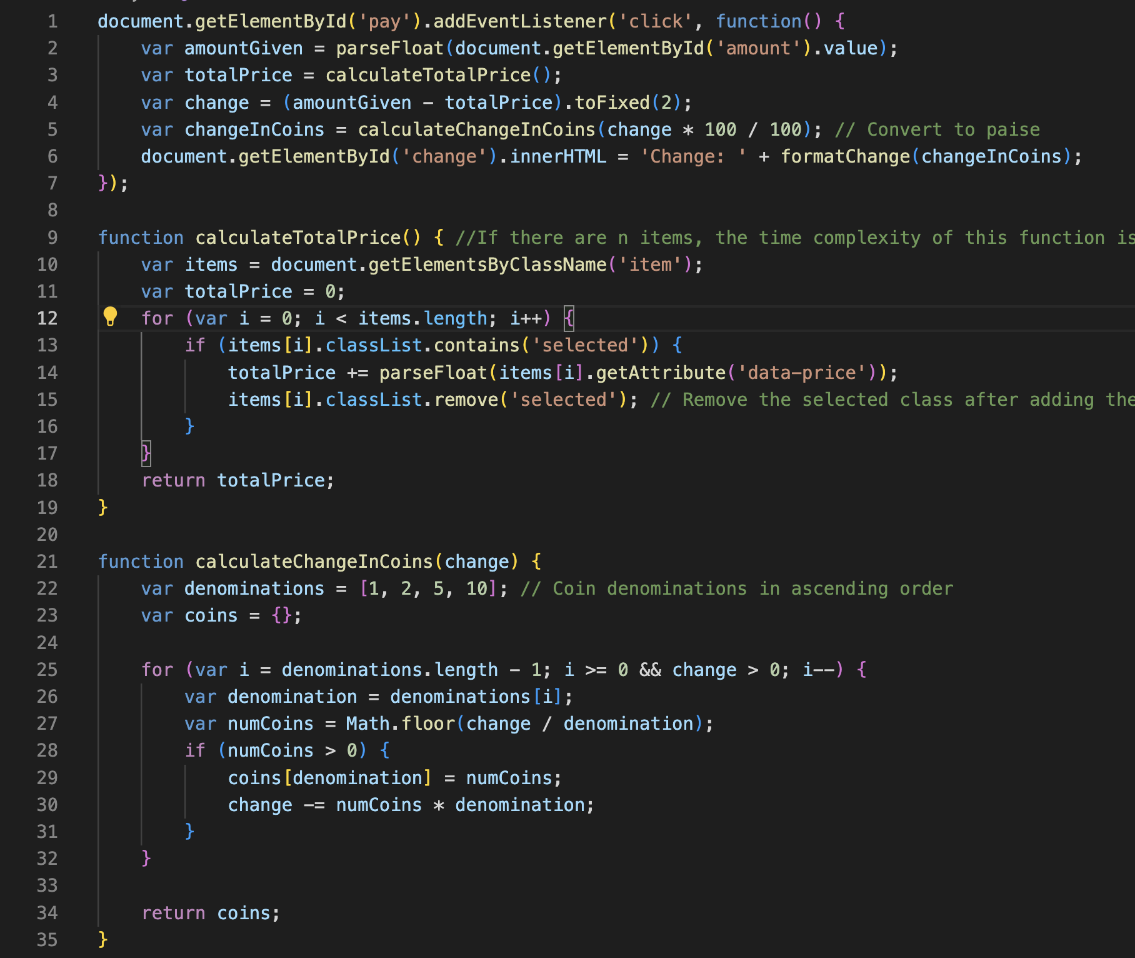
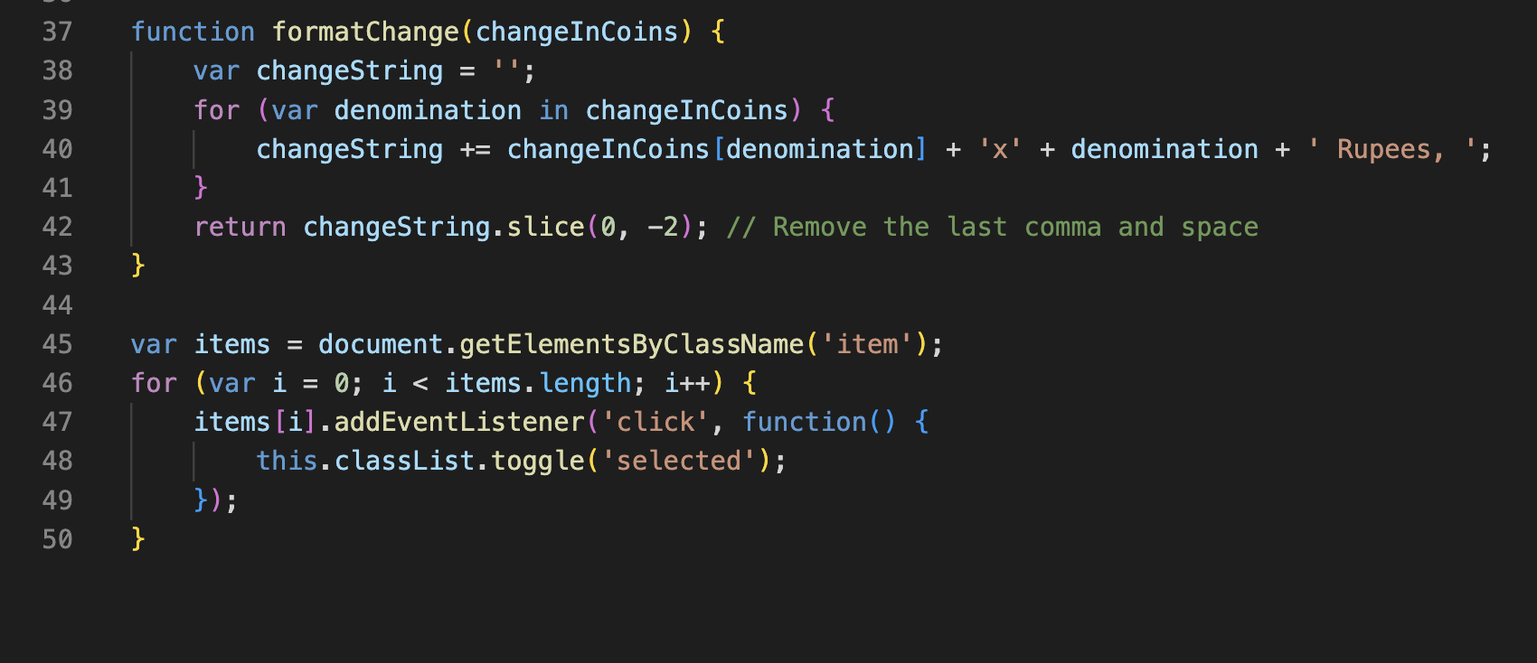

Slide 8
Time complexity
Event Listener for 'pay' button click: This event listener triggers the calculation of the change. Since this event listener is triggered only once when the 'pay' button is clicked, its time complexity can be considered as O(1).
calculateTotalPrice() function: This function iterates over all items to calculate the total price. If there are 'n' items, the time complexity of this function is O(n).
calculateChangeInCoins() function: This function calculates the change in coins based on the given change. It iterates over the coin denominations, which are fixed at [1, 2, 5, 10] in ascending order. The number of iterations depends on the number of denominations, which is constant. So, the time complexity of this function is O(1).
formatChange() function: This function formats the change in coins. It iterates over the keys of the 'changeInCoins' object, which contains the coin denominations. Let's denote the number of denominations as 'm'. The number of iterations in this function depends on the number of denominations, so its time complexity is O(m).
Event Listeners for items: These event listeners toggle the 'selected' class of the clicked item. If there are 'n' items, the time complexity of adding these event listeners is O(n).
Time Complexity : O(n)

Slide 9
Thank you

